Slide 1


Slide 2


Slide 3
Course outline:
1. Brief History of AWS
2. AWS Features
3. How to Create Account in AWS
4. Introduction to EC2,IAM,S3,EBS,CLI,RDS,VPC,SNS&SQS
5. Features of EC2
6. EC2 Dashboard Overview
7. About Amazon Machine Images (AMI)
8. Different types of AMI’s
9. How to create AWS AMI
10. How to create a Key Pairs
11. What is EBS Volumes
12. Download a key pairs
13. How to connect EC2 instances
14. What is pem file
15. What is ppk file
16. What are default usernames to connect AMI’s
17. How to Login into LINUX AMI
18. How to reboot the Instance
19. How to stop instance
20. How to terminate instance

Slide 4
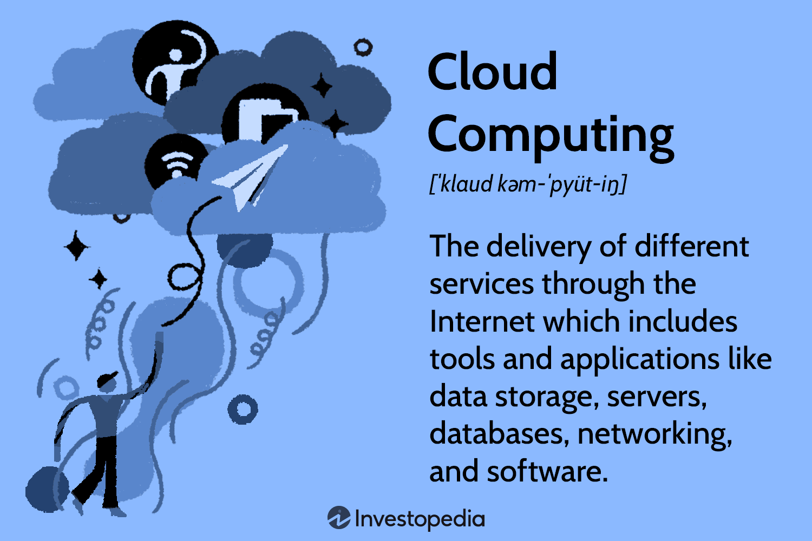
What is cloud computing?

Slide 5
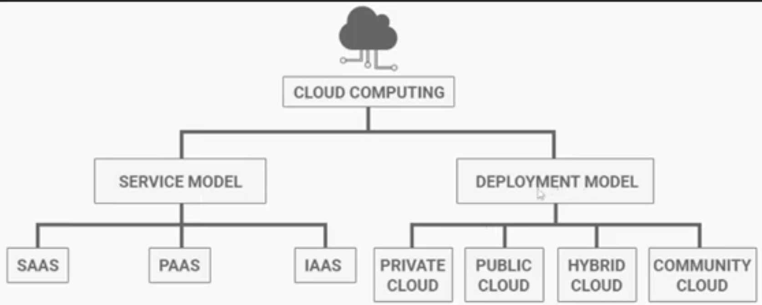
Modes of cloud computing

Slide 6
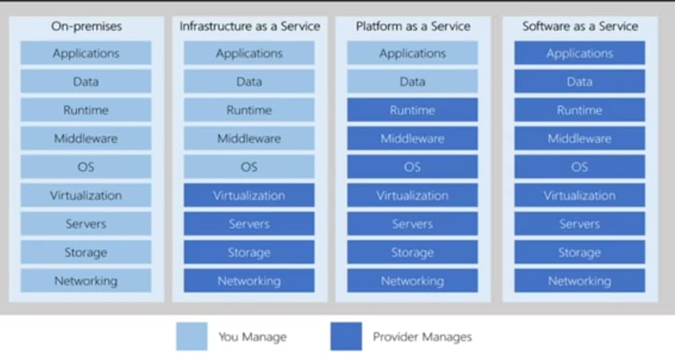

Slide 7


Slide 8


Slide 9
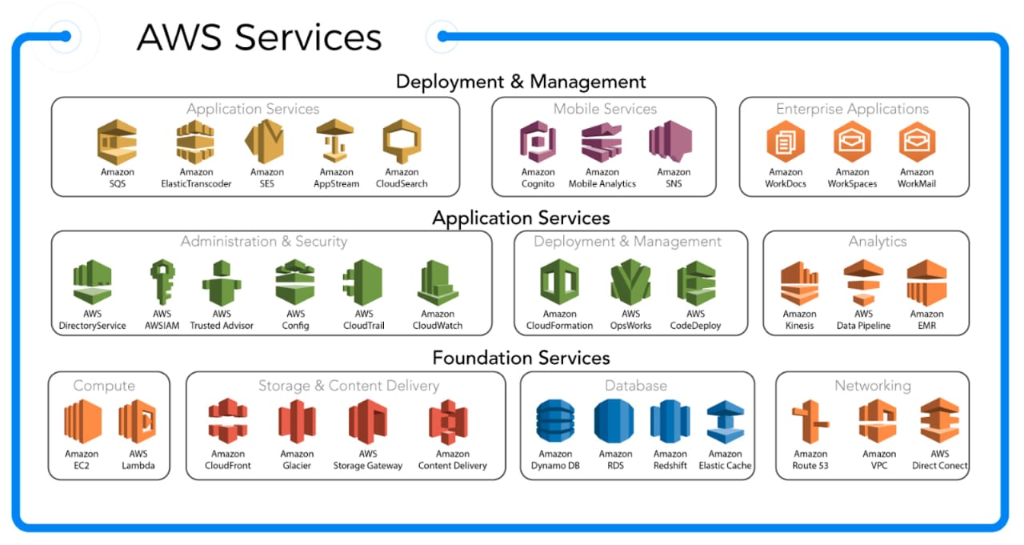

Slide 10
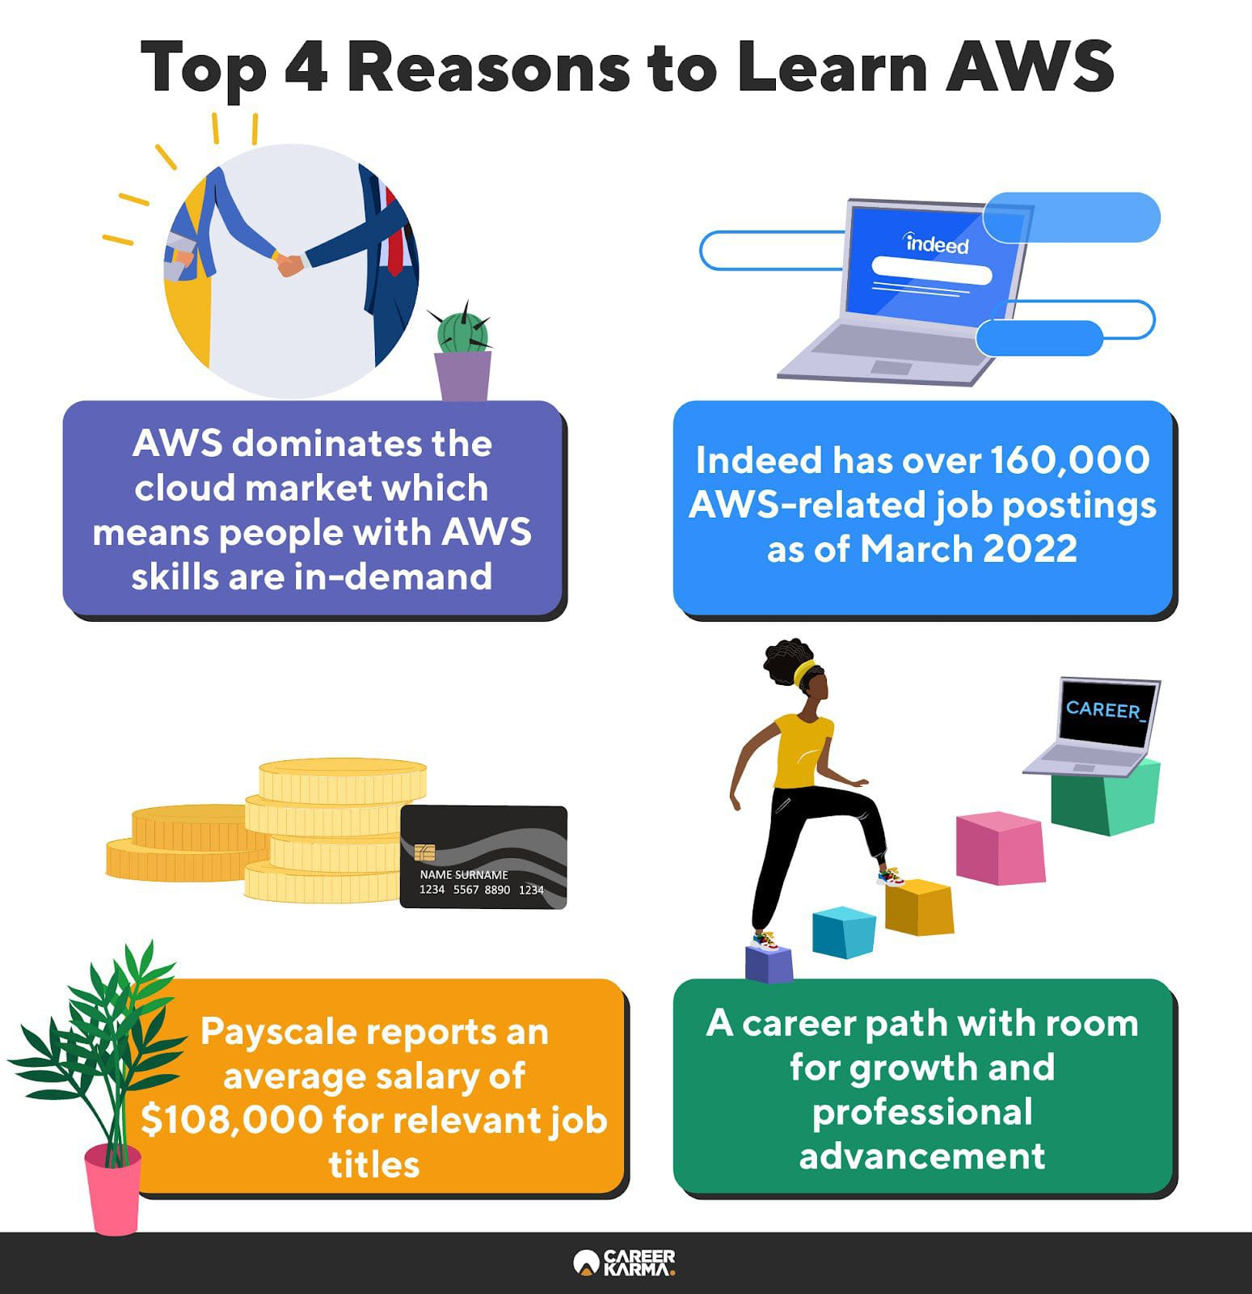
Why should we learn AWS ?

Slide 11
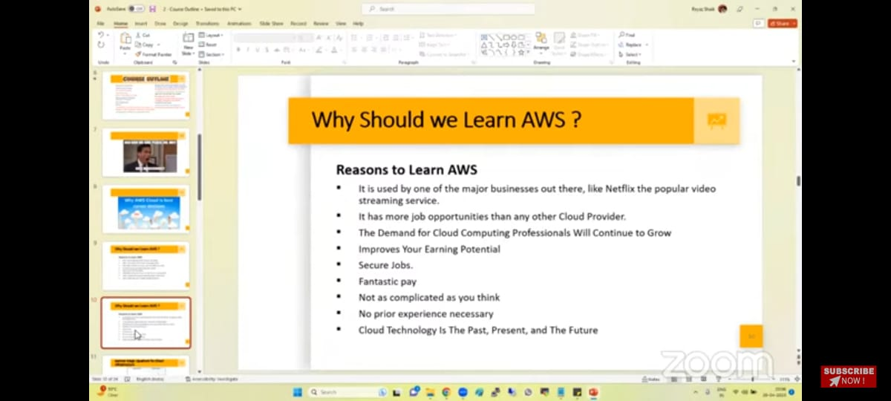

Slide 12
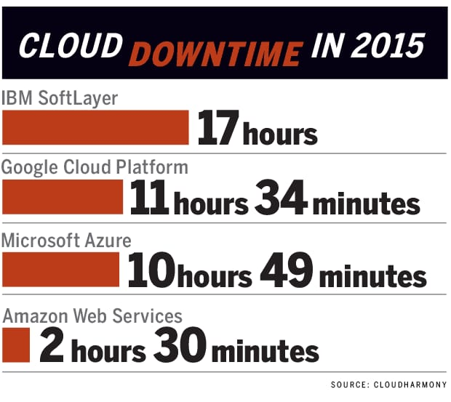
Why should we learn AWS ?

Slide 13
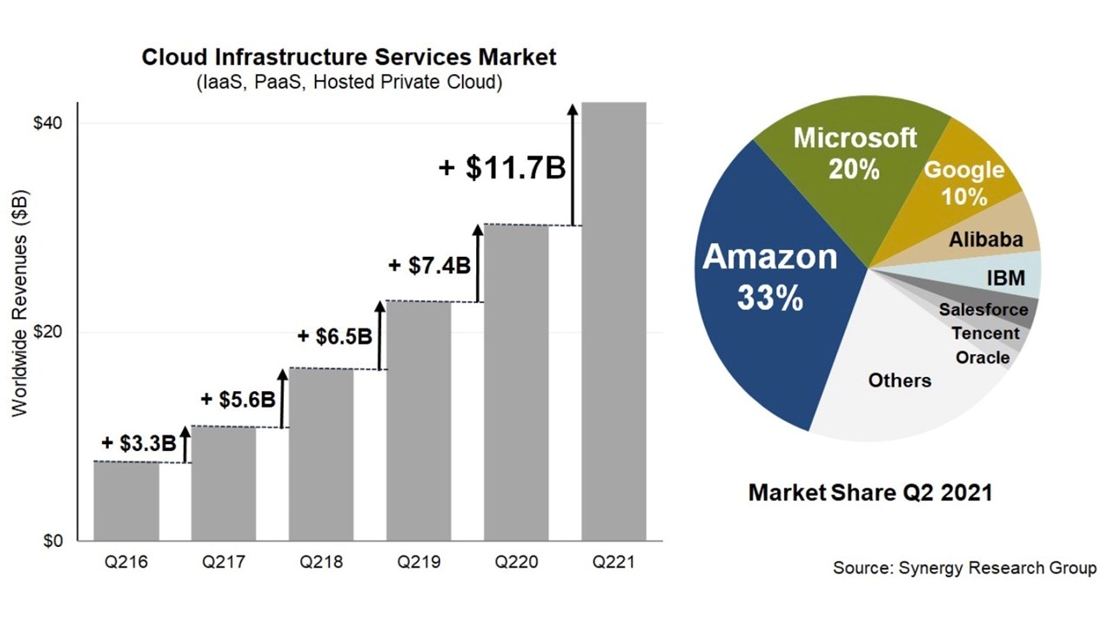
Why should we learn AWS ?

Slide 14
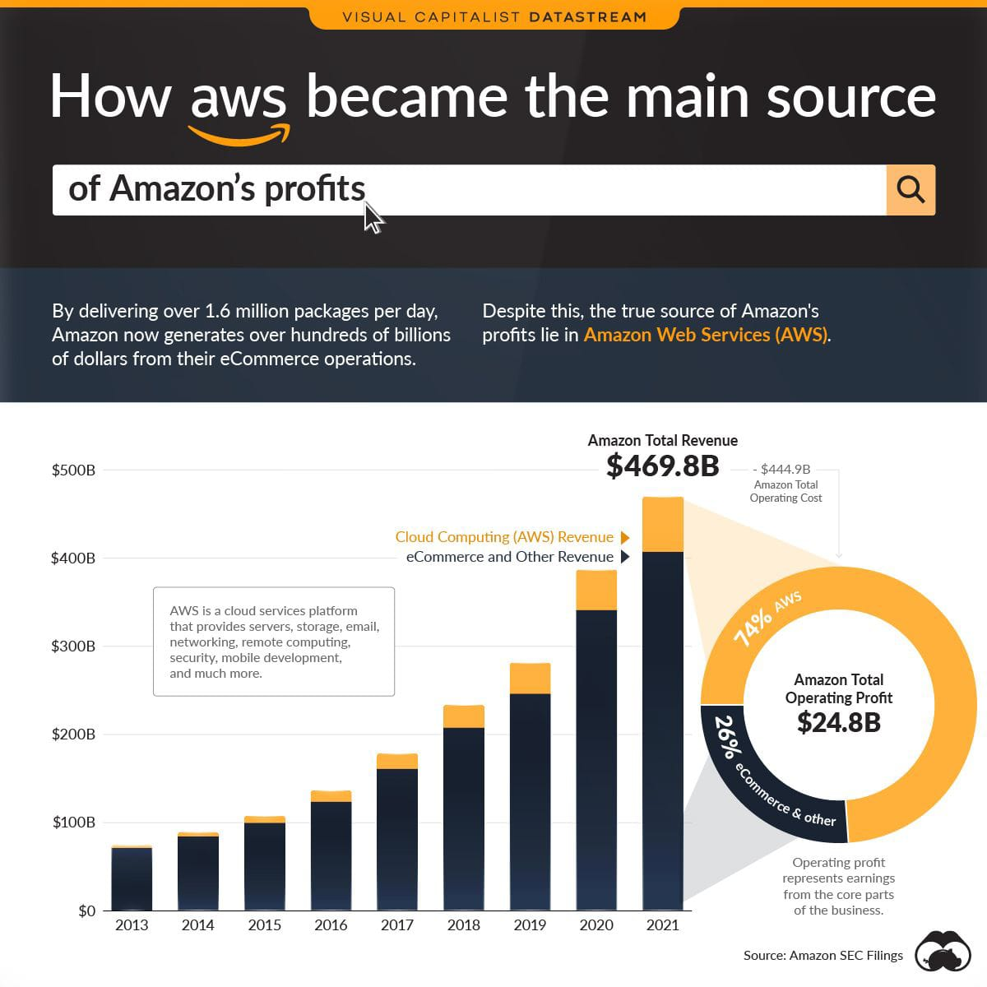
Why should we learn AWS ?

Slide 15
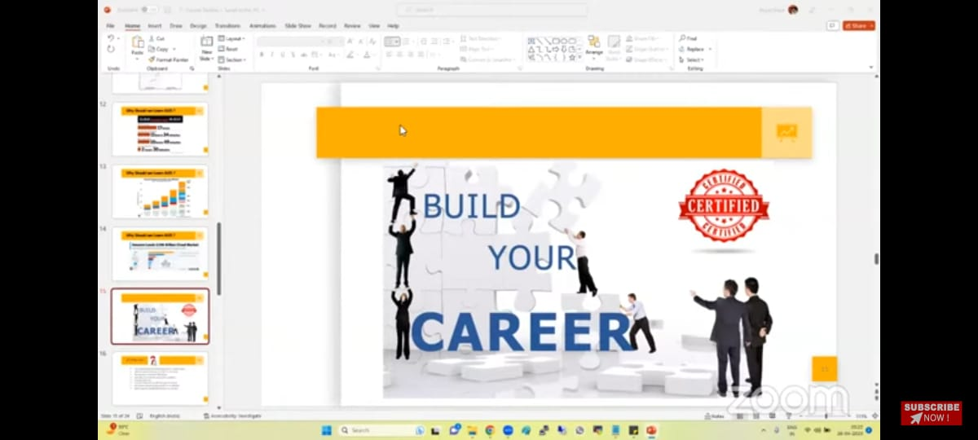

Slide 16
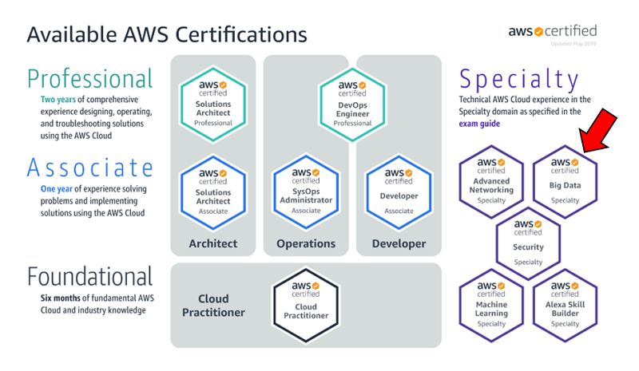

Slide 17
